Slide 1

See Batteries Differently
Andrew Hsieh
andrew@feasible.io
Notes:
Hey everyone, My name is Andrew Hsieh and I’m a Co-Founder of Feasible. At Feasible, We're using sound to change the way we see batteries.
Show of hands: Who's been on an airplane in the last month or so?
Okay so keep those hands up if you’ve heard one of the many announcements about the FAA ban on the Samsung Galaxy Note 7?

Slide 2
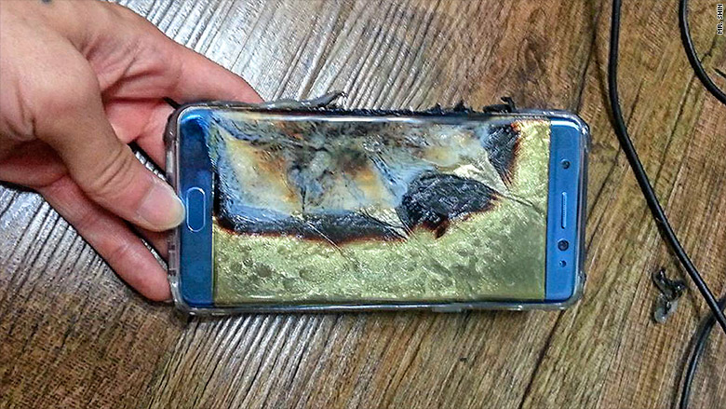
> $1,000,000,000 error
Notes:
Estimates for how much this recall cost Samsung sit in the Billions of Dollars. And the culprit …seems to be undetected defects in the batteries.
(pause) So you have a failure in quality control, which led to over a billion dollars in pain for Samsung.
In broad strokes, this happened because [CLICK]

Slide 3
Battery Industry Today
≈ Healthcare in 1800s
Notes:
The Battery Industry today is a lot like healthcare in the 1800s

Slide 4
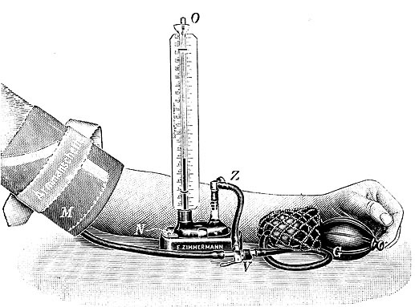
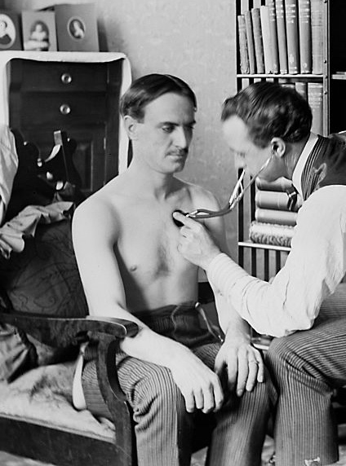
Healthcare in 1800s
Notes:
Back then, doctors could only diagnose someone using surface deep tools like blood pressure or heart rate, which give practically zero insight into the inner workings of the human body.
(pause)
So life expectancy was pretty poor back then.

Slide 5
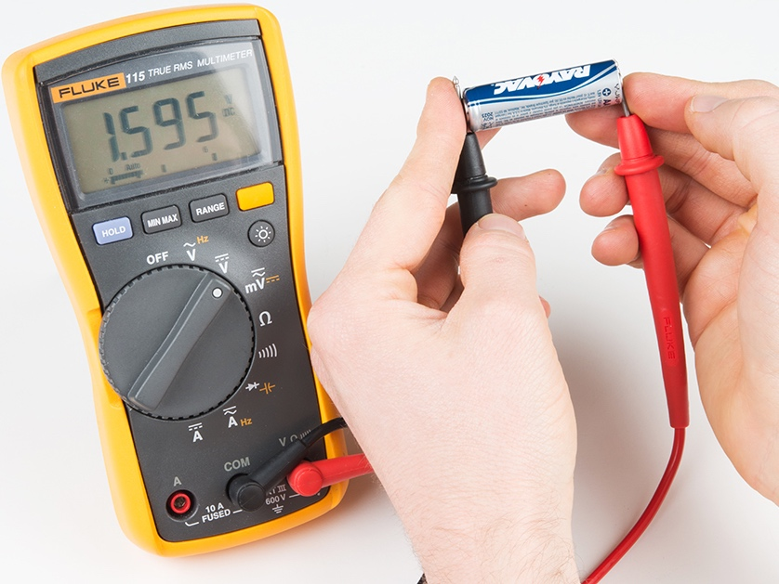
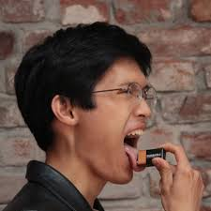
Battery Industry Today
Notes:
Similarly, in the battery industry today, at scale diagnostics are limited to surface deep methods like voltage and current measurements, which also don’t give good information on what’s happening inside a battery
(pause)
This is why you get things like [CLICK]

Slide 6
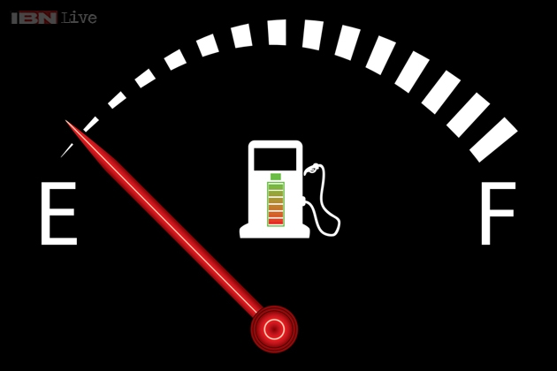
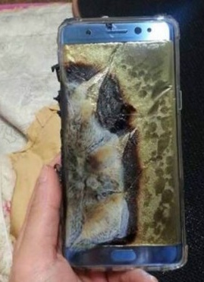
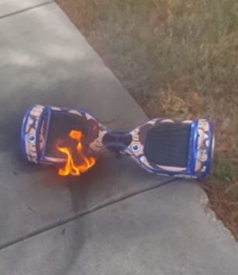
Notes:
range anxiety [CLICK] and exploding devices. So there's a huge need for better at-scale diagnostics in batteries

Slide 7
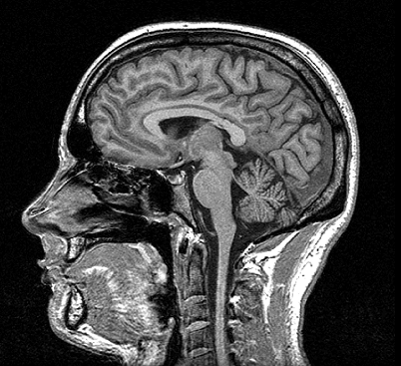
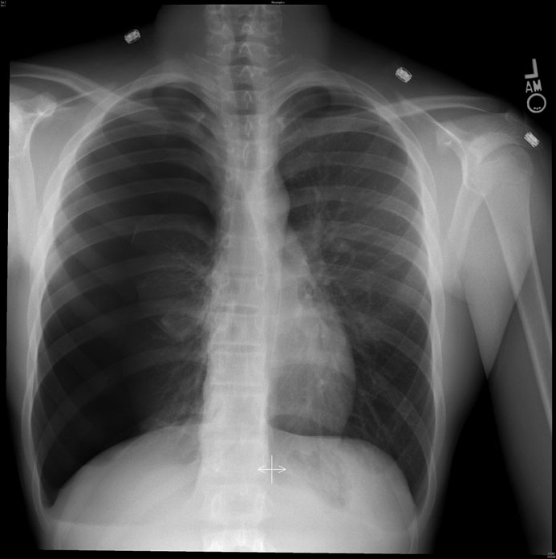
Notes:
The advent of medical imaging revolutionized diagnostics and quality of care in medicine
But, this shift hasn’t happened yet in batteries, and that’s where Feasible comes in

Slide 8
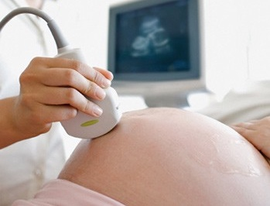
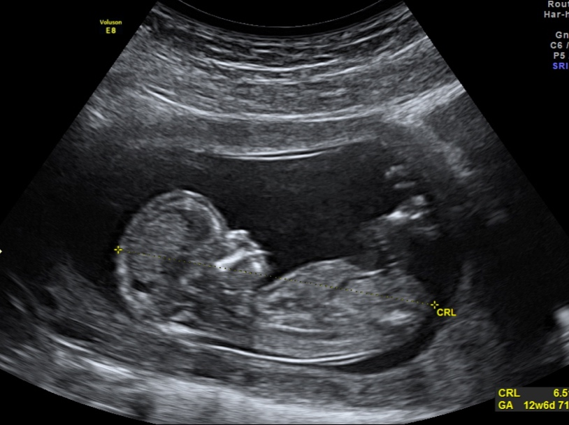
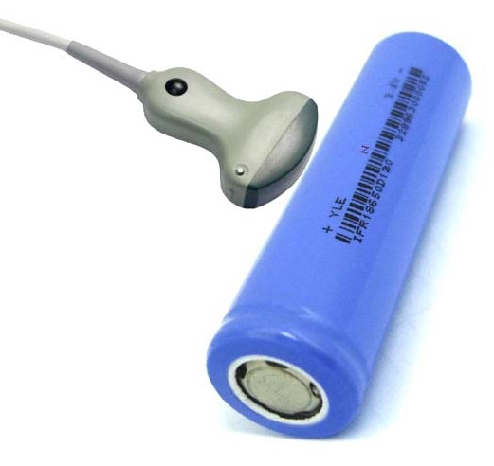
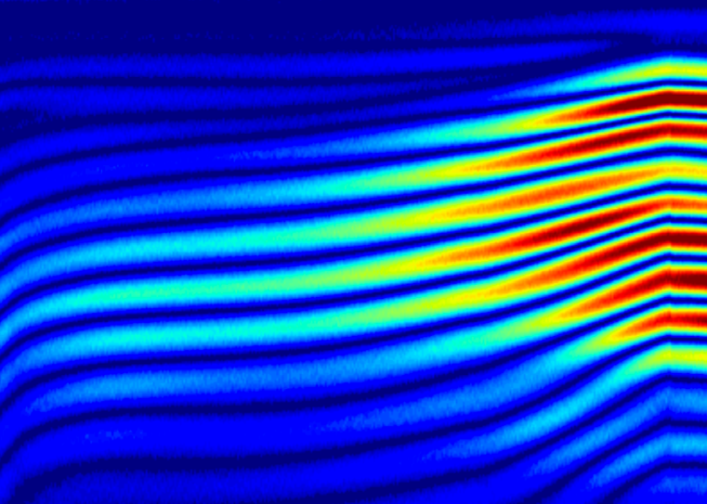
Discharging AA
Notes:
In the same way that medical ultrasound is a non-invasive tool see inside the human body
[CLICK]
At Feasible, we use ultrasound to see inside batteries to unlock new physical insights about them.

Slide 9



Ultrasound for Batteries
Pulse
Listen
Learn
Notes:
The basic measurement is simple.
[CLICK] You send a pulse of sound into a battery, and
[CLICK] listen to the sound bounce around.
[CLICK] and based on that echoing behavior plus some knowhow and analytics, you can learn a lot about a battery’s internal condition.

Slide 10
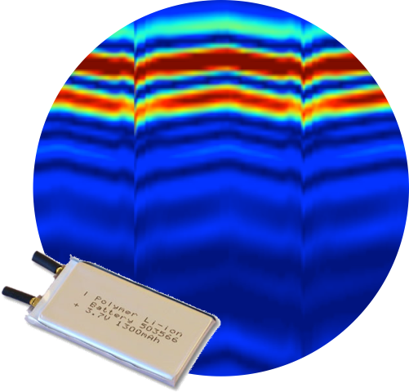
Works on any battery
Notes:
We’ve tested this extensively on commercial batteries of all types and it works on every single one.
[CLICK]

Slide 11
Fast
Non-damaging
Scalable
Notes:
What’s more, This is a fast, non-destructive measurement that is readily scalable, which means we can test batteries in real time and in high throughput.
(pause)
In the trend towards electrification, our hardware and analytics will be the picks and shovels for the rapidly growing battery industry

Slide 12





Academia
Government
Industry
Active talks with:
2 Battery Manufacturers
3 Battery Integrators
Notes:
In the roughly 2 years since our technology was invented at Princeton, there’s been a lot of interest in the unique insights that our tools can provide.
We’re received financial support from several government agencies, and we’re in active talks with strategic partners to develop our hardware and analytics towards the quality control market.

Slide 13
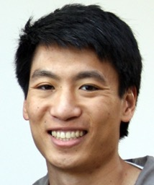

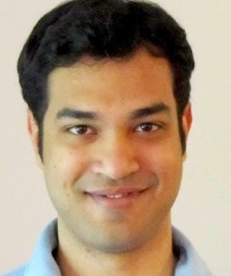
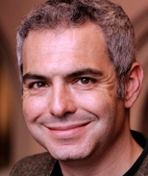

Andrew Hsieh
PhD
Batteries/Materials
Barry Van Tassell
PhD
Software/Analytics
Shaurjo Biswas
PhD
Hardware/Sys Design
Daniel Steingart
PhD
Batteries/Software
Anne Wilkinson
BS
Software/Analytics
Notes:
At Feasible, our mission is to empower the growing battery industry with the tools to build better, safer batteries. This will not be an easy task, but we have an excellent team that is well equipped to meet the challenges that lay ahead.

Slide 14
Thanks!
Andrew Hsieh
andrew@feasible.io
Notes:
If you’re interested in learning more about ultrasound for batteries, we’d love to talk to you at the reception.
Thanks!

